Slide 1

Chinook Data Warehouse and Employee Performance Analysis
A Comprehensive Business Intelligence and Machine Learning Project
TeamOne
Dimitra Sagies
Stelios Karouzos
Athanasios Alevizos
Elias Sarousavvidis
28/01/2025

Slide 2


Project Overview
Business Requirements:
- Create a Data Warehouse (DW) for Chinook’s OLTP database.
- Extract and analyze sales performance data.
- Implement a Machine Learning model for employee performance prediction.
Outcomes:
- Enable better decision-making through reporting and analytics.
- Gain insights into employee performance and sales strategies.
Discussion of requirements of the project. Sharing project ideas and plan on how to work on the project.
Individual work on the same topic
Meetings to implement and combine our ideas
Our approach

Slide 3




ETL and PowerBi
OLTP
DataWarehouse
● Chinook
● Star schema selection
● Tables include fact table (FactSales) and dimensions (DimEmployee, DimCustomer, DimDate, DimTrack)
● Load: Populating the DW with transformed data
● Creation of constraints between tables
● Extraction: SQL scripts or SSIS package to extract data from OLTP database.
● Transformation: Cleaning and structuring data for DW
● Creation of the report
● Useful insights
● Analysis
Staging Area
PowerBi

Slide 4
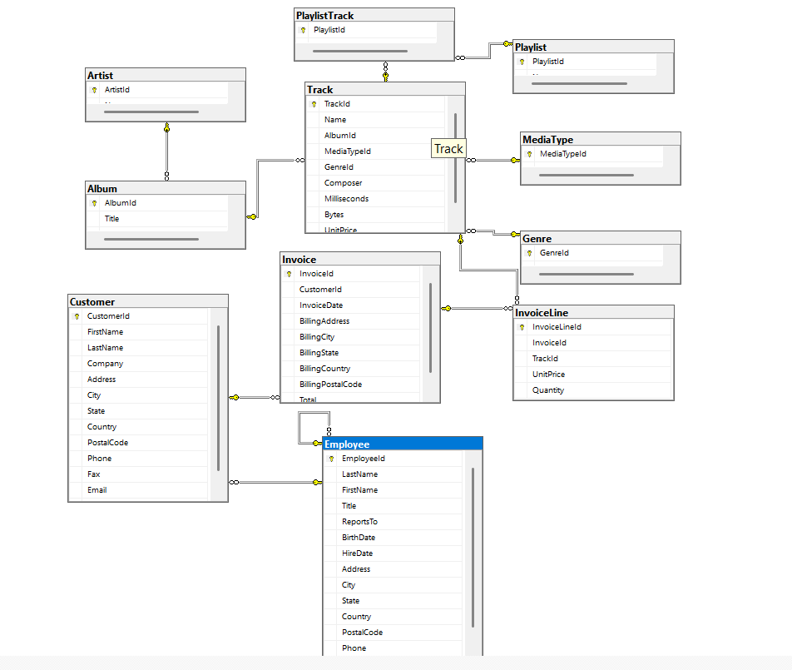
Chinook OLTP Schema

Slide 5
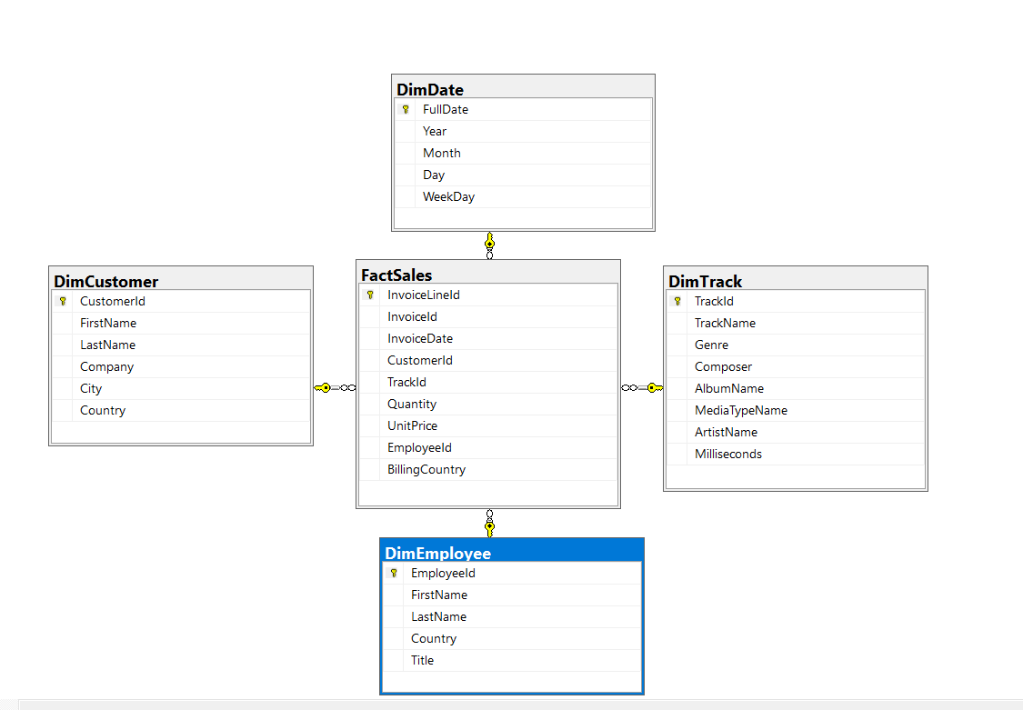
Chinook DataWarehouse Schema

Slide 6
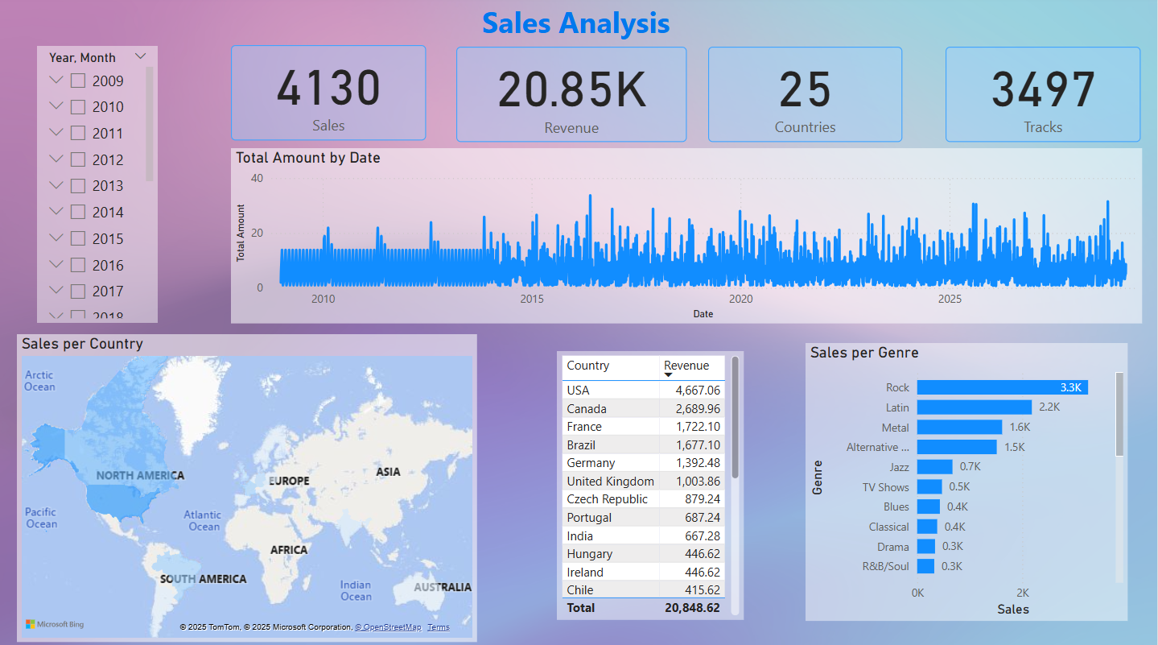
POWER BI Demo

Slide 7
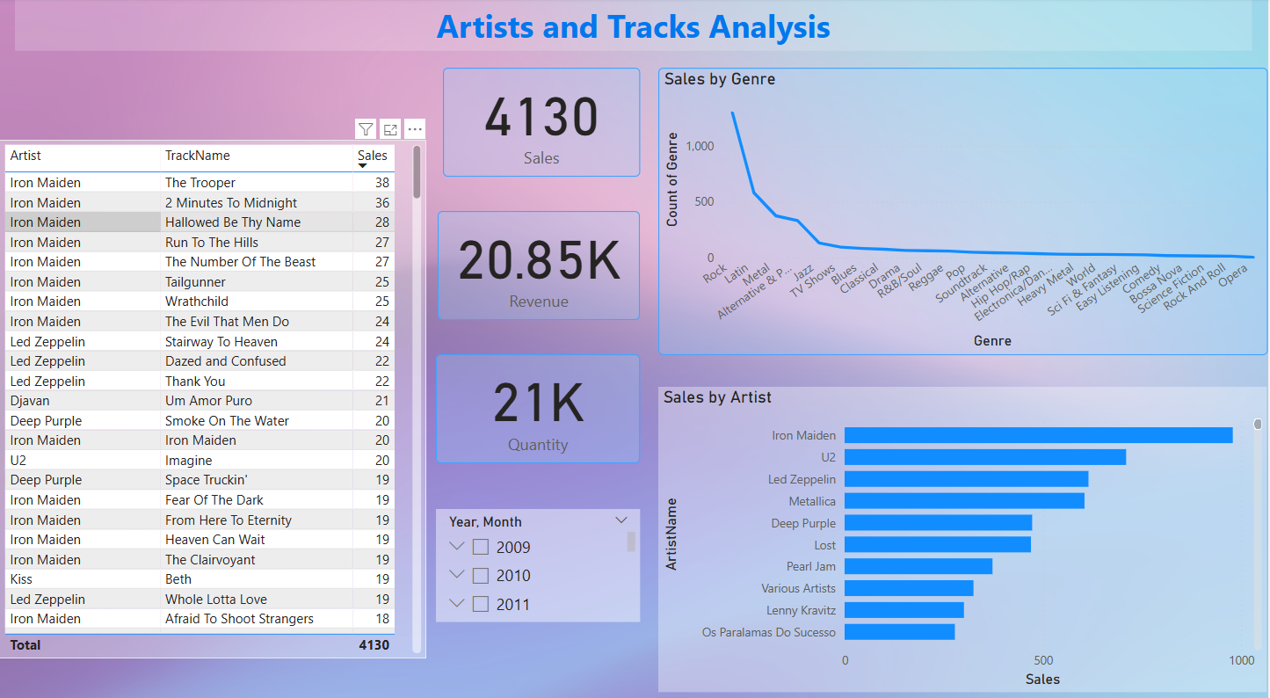
POWER BI Demo

Slide 8
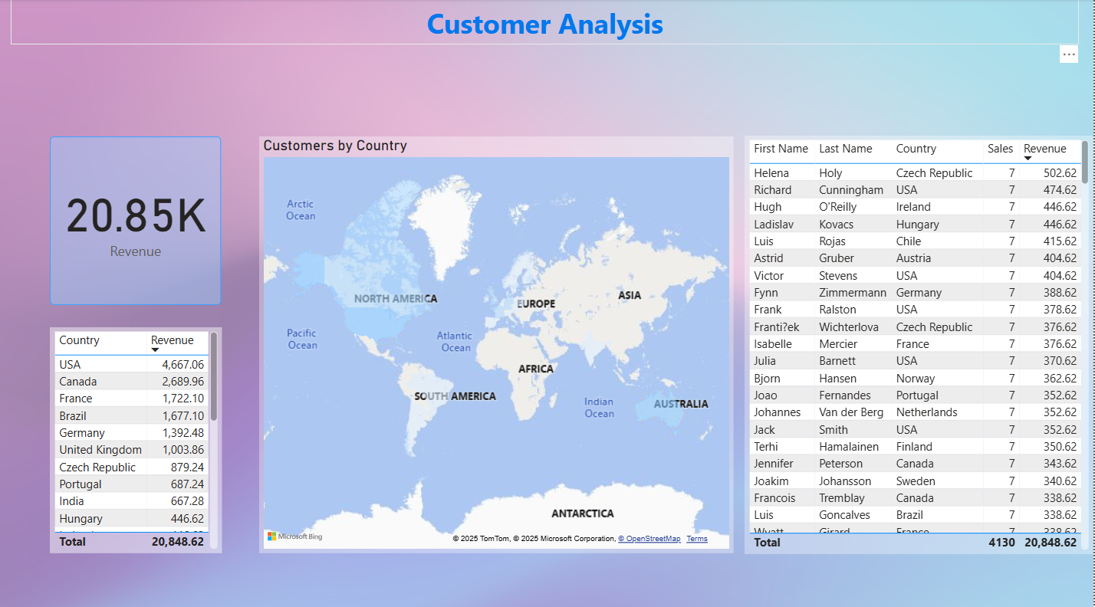
POWER BI Demo

Slide 9

Interesting outcomes from PowerBi
Revenue : 20.848€
25 countries (Top 3: USA, Canada and France)
Top sales: Rock Genre
Τop Artist: Iron Maiden
4 out of Top 5 customer, from countries outside of Top 5 countries

Slide 10


Data Extraction, Preprocessing and Performance Categorization
Extraction:
- SQL query to join and aggregate data from Employee, Customer, and Invoice tables.
- Metrics calculated: Total revenue, invoices, and average revenue per customer.
Preprocessing:
- Data cleaning and transformation.
- New features created, such as employee tenure.
Categories:
- High, Average, and Low Performers based on revenue thresholds.

Slide 11
Machine Learning Pipeline
Data splitting
Train: 80%, Test: 10%, Holdout: 10%
Initial Evaluation
Focused on F1-score (combines Precision & Recall for harmonic mean)
K-Fold Validation
Conducted across 4 models with consistent performance
Model Selection
Chose SVM and RandomForest to analyze coefficients and feature importance
Hyperparameter Tuning
Used Grid Search for optimization
Training
Hyperparameters used
Final Model Evaluation
Assessed F1-score on Holdout set

Slide 12
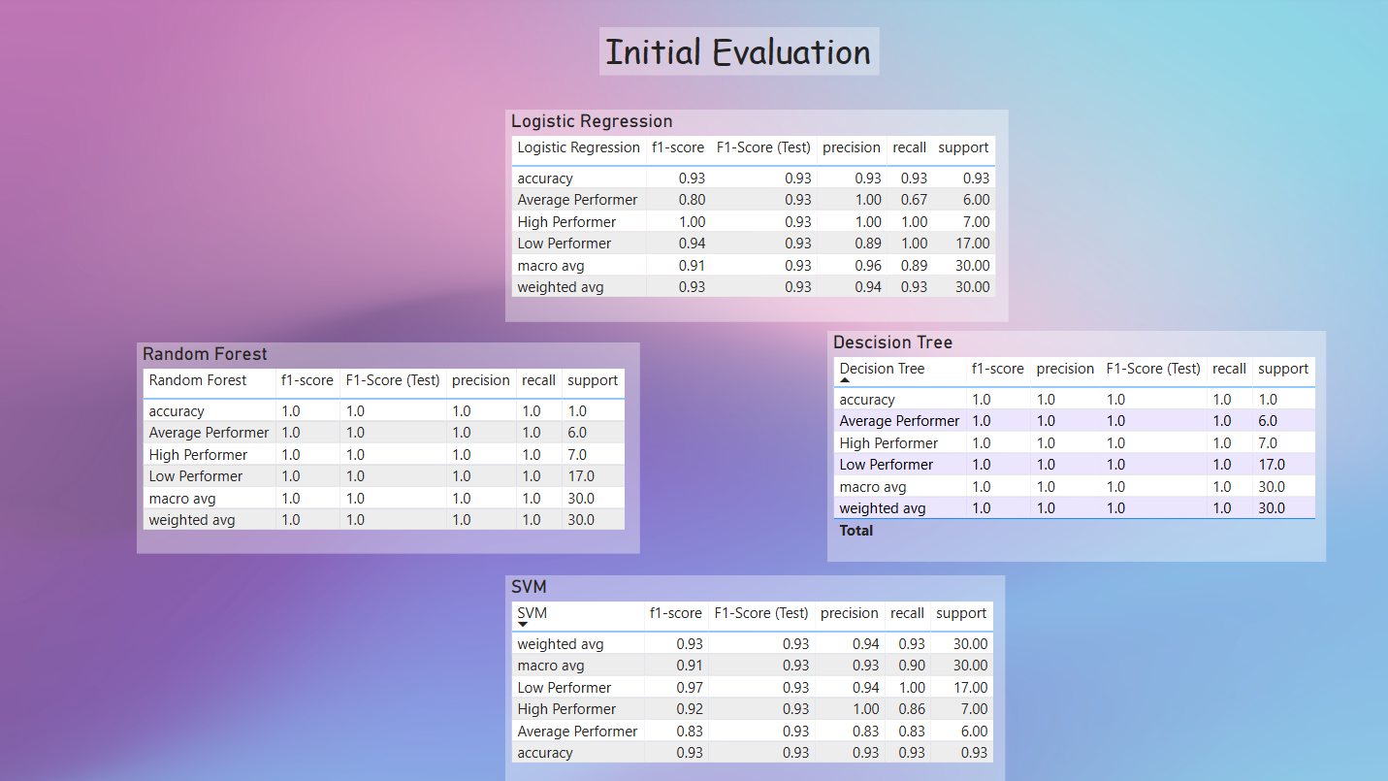
Machine Learning Results

Slide 13
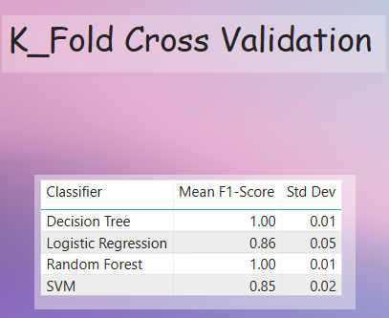
Machine Learning Results

Slide 14
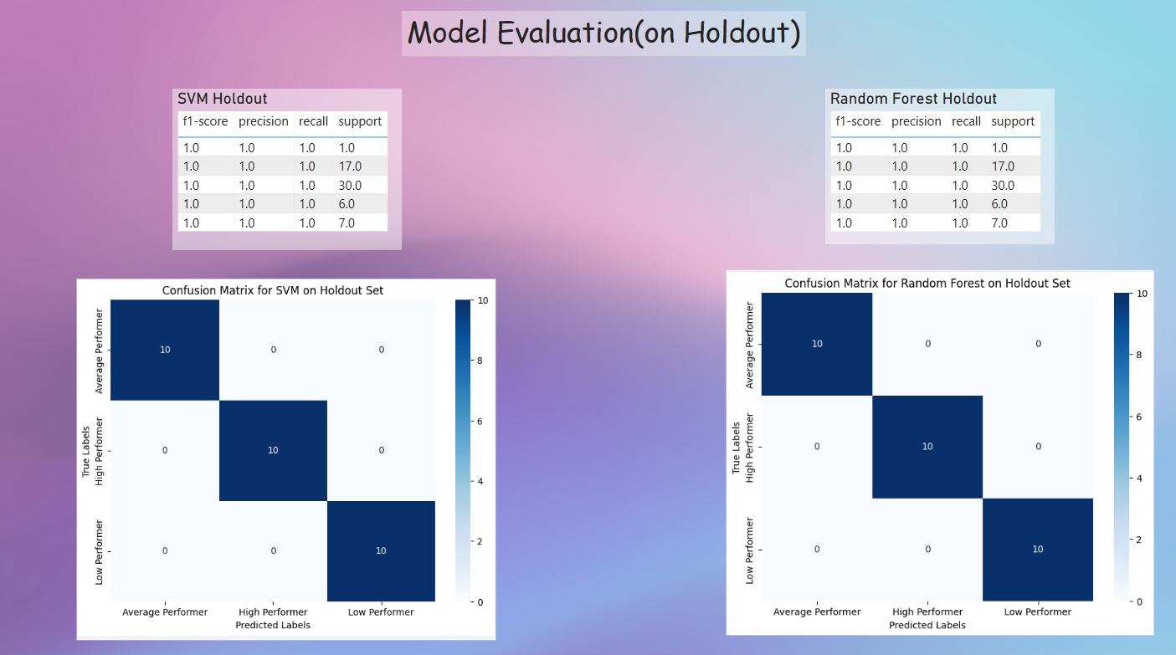
Machine Learning Results

Slide 15
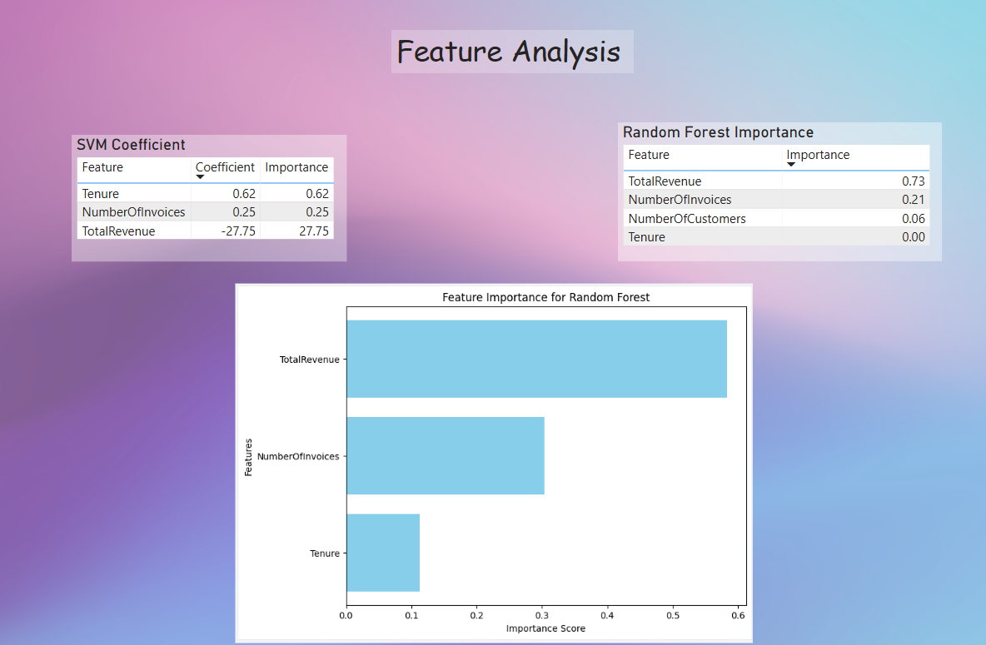
Machine Learning Results

Slide 16
Recommendations
Give reasons to employees with higher tenure to stay motivated (Bonuses, improvements in the workspace, better work-life balance)
Assign more experienced employees to newer ones as “mentors”
Focus on Rock and Latin tracks. Keep a close eye on new trends in music
Give exclusive discounts on top customers
Focus marketing on countries with lower sales

Slide 17

Challenges
Database challenges such as Null and zero values at revenue even though there were sales entries associated with them.
Some sales weren’t assigned to a specific country
Small dataset for Machine Learning, almost perfect scores for models

Slide 18
Thank you!
QnA

